Slide 1
Dimensions of Human Behavior: Person and Environment
Sixth Edition
Elizabeth D. Hutchison

Slide 2
Chapter 11
Small Groups

Slide 3
Small Groups in Social Work
Small group: “two or more people who interact with each other because of shared interests, goals, experiences, and needs” (Ballantine, Roberts, & Korgen, 2018, p. 129)
  Opportunity to meet others and work together to achieve a mutual goal
  Provide social support
  Important source of social capital
Hutchison, Dimensions of Human Behavior, 6e
SAGE Publishing, 2019

Slide 4
Small Groups in Social Work
The philosophy of group work has shifted throughout the years
  Late 1800s and early 1900s: took place in settlement houses; focused on recreation, social integration, immigration issues, character building, and social reform
  1930s and 1940s: formal organizations promoted group work
Hutchison, Dimensions of Human Behavior, 6e
SAGE Publishing, 2019

Slide 5
Small Groups in Social Work
  During WWII: took place in hospitals and other clinical settings
  After WWII: shifted from a strengths to a more problem-focused orientation
Hutchison, Dimensions of Human Behavior, 6e
SAGE Publishing, 2019

Slide 6
Small Groups in Social Work
  1960s and 1970s: social work education included courses on group work; could major in “group work”
    Group work content declined—social work education shifted its focus to individuals and families
  1980s and 1990s: rise of mutual aid groups
Hutchison, Dimensions of Human Behavior, 6e
SAGE Publishing, 2019

Slide 7
Small Groups in Social Work
  Currently: managed care era, groups are viewed as a cheaper method of service delivery
  Empirical studies have shown groups to be effective in addressing several social, health, and emotional problems
Hutchison, Dimensions of Human Behavior, 6e
SAGE Publishing, 2019

Slide 8
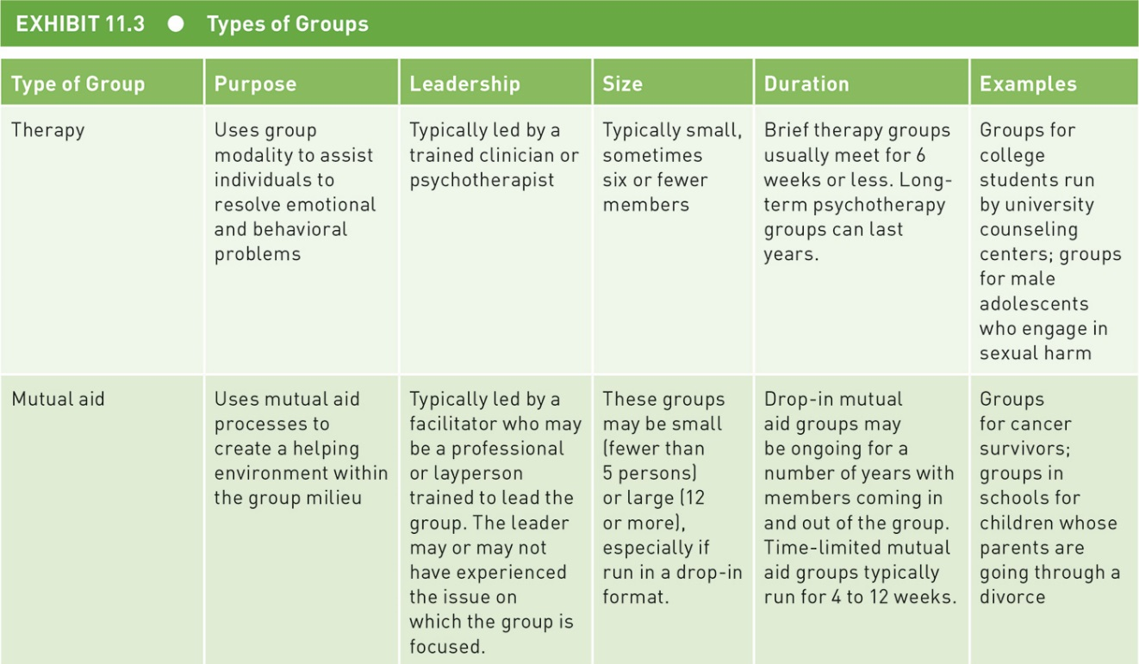
Types and Characteristics
Hutchison, Dimensions of Human Behavior, 6e
SAGE Publishing, 2019

Slide 9
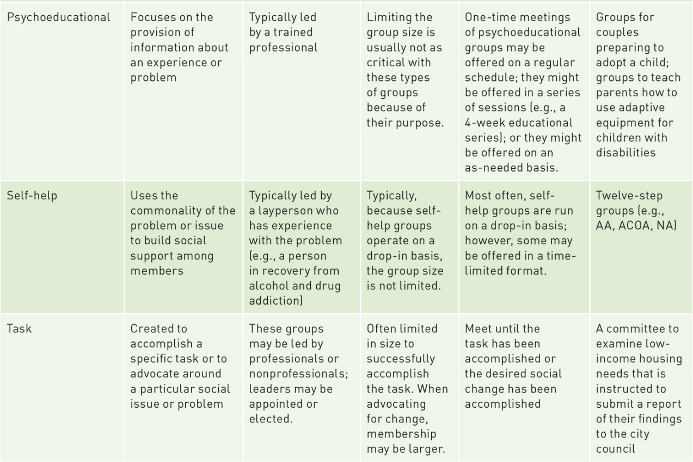
Types and Characteristics
Hutchison, Dimensions of Human Behavior, 6e
SAGE Publishing, 2019

Slide 10
Virtual Groups
Members do not meet face-to-face; meet by telephone or internet
Considerations when deciding to use virtual groups
  Member access to telephones or computers
  Ethical issues such as personal privacy, boundaries, safety, client confidentiality
  How the social worker acts on social media sites
  Privacy for student/professional personal network sites should be monitored
Hutchison, Dimensions of Human Behavior, 6e
SAGE Publishing, 2019

Slide 11
Virtual Groups
Advantages
  More cohesive groups
  Do not focus on personal features
  Convenience
  Ability to reach more people, homebound people, or those far away
  Easier to self disclose
Disadvantages
  Hard to subtle verbal cues and individual participation
  Difficult to gauge others’ reactions
  Problems related to technology
  Background noise
  Not as well studied
Hutchison, Dimensions of Human Behavior, 6e
SAGE Publishing, 2019

Slide 12
Virtual Groups
Becoming increasingly more popular
Can decrease depression and anxiety
Increases belonging and connections with others
May require more training
Need to navigate time zones
Hutchison, Dimensions of Human Behavior, 6e
SAGE Publishing, 2019

Slide 13
Dimensions of Group Structure
How groups develop
  Formed groups: defined purpose; started through outsider efforts, such as an agency
  Natural groups: spontaneous; established due to friendship, location, or some naturally occurring event
How long they last
  Time-limited: set time for termination
  Ongoing: no defined endpoint
Hutchison, Dimensions of Human Behavior, 6e
SAGE Publishing, 2019

Slide 14
Dimensions of Group Structure
How they determine membership
  Open: new members can join throughout the group’s life
  Closed: after minimum and maximum number determined, others are prohibited from joining
Formed and natural groups may be time-limited or ongoing, short or long term
A group can start off open and become closed; a closed group may open up
Hutchison, Dimensions of Human Behavior, 6e
SAGE Publishing, 2019

Slide 15
Group Composition
Heterogeneity vs. homogeneity
  Variation regarding age, race, sexual orientation, gender, level of education, coping styles, religion, SES, disabilities, etc.
  May be homogenous on a couple of these dimensions, but heterogeneous on the rest
  Which is better? It depends
  Group member perceptions
Group composition more complex than once thought
Hutchison, Dimensions of Human Behavior, 6e
SAGE Publishing, 2019

Slide 16
Homogeneity/Heterogeneity in Group Composition: Social Justice Issues
Social group workers
  Recognize equal rights of people in their communities to access social work groups
  Develop groups homogeneous on important identity dimensions
  Empower groups, support self-advocacy, and advocate for groups
  Develop groups heterogeneous on important social identity issues and homogeneous on group purpose
Hutchison, Dimensions of Human Behavior, 6e
SAGE Publishing, 2019

Slide 17
Theories of Group Processes
Psychodynamic: addresses the unconscious emotional thoughts that interfere with the member’s ability to interact with others
  Help members identify how their interactions with other members are similar to how they interaction with non-group members
Hutchison, Dimensions of Human Behavior, 6e
SAGE Publishing, 2019

Slide 18
Theories of Group Processes
Symbolic interaction: symbols are created, exchanged, and interpreted; individual and social change happens as meanings are made and changed through the use of symbols
  “Group” itself is a symbol, members create a sense of being in a “group,” build own symbols and meanings
Hutchison, Dimensions of Human Behavior, 6e
SAGE Publishing, 2019

Slide 19
Theories of Group Processes
Status characteristics and expectation states: initial interactions in groups are affected by the level of influence and participation of the member; related to the status and the perceptions others hold of the member’s ability to help complete group goals
Hutchison, Dimensions of Human Behavior, 6e
SAGE Publishing, 2019

Slide 20
Theories of Group Processes
Exchange: social power determines who gets valued resources and whether those resources are perceived as being distributed in a just manner
Self-categorization: stereotype attributes of in-groups and out-groups; in-group members are more influential later than out-group members due to bias
Hutchison, Dimensions of Human Behavior, 6e
SAGE Publishing, 2019

Slide 21
Group Development
Stage theories and models
  Progressive stage models: sequential stages that build upon each preceding stage
  Cyclical models: stages can be moved between rather than linearly
  No agreement among researchers on stage number, order, or the character of the stages
Process models
  Identify what goes on in groups and how those processes affect members and their interactions
Hutchison, Dimensions of Human Behavior, 6e
SAGE Publishing, 2019

Slide 22
Group Dynamics
Formal and informal leadership
  Task-oriented leaders: facilitate problem-solving
  Process-oriented leaders: identify and manage group relationships
Formal and informal roles
  Members assume roles to fulfill group’s purpose and members’ personal needs; have both positive and negative aspects
Hutchison, Dimensions of Human Behavior, 6e
SAGE Publishing, 2019

Slide 23
Group Dynamics
Communication networks
  Links among members
  Who talks to whom, how information is transmitted, whether communication between members is direct or uses a go-between
  What type of communication device is used
    Computer, telephone, face-to-face
Hutchison, Dimensions of Human Behavior, 6e
SAGE Publishing, 2019

Slide 24
Group Cohesiveness
Dynamic process reflected in the tendency for the group to stick together and be unified in the pursuit of its objectives and the satisfaction of member emotional needs
  Task cohesion: degree to which group members work toward common goal
  Social cohesion: level of intimacy and positive regard among group members
Cohesive groups are more effective
Hutchison, Dimensions of Human Behavior, 6e
SAGE Publishing, 2019

Slide 25
Interdisciplinary Teams and Social Work
Interdisciplinary teams
  Composed of professionals representing a variety of disciplines
  Work in organized collaboration to solve a common set of problems
  May include consumers or clients
  Advantage to work well with others to best help group members
Hutchison, Dimensions of Human Behavior, 6e
SAGE Publishing, 2019

Slide 26
The Social Worker’s Role on the Interdisciplinary Team
How effective are interdisciplinary teams?
  Increased coordination and collaboration between agencies
  Increased information exchange
  Broader range of viewpoints heard
  Enhanced communication
  Increased moral support and confidence
Hutchison, Dimensions of Human Behavior, 6e
SAGE Publishing, 2019

Slide 27
The Social Worker’s Role on the Interdisciplinary Team
What are the special problems social workers face on interdisciplinary teams?
  Difficulty developing shared goals and objectives
  Conflicting theories and ideologies
  Turf disputes, power struggles, agency territorialism
  Confusion about leadership roles
  More time-consuming decision making
Hutchison, Dimensions of Human Behavior, 6e
SAGE Publishing, 2019

Slide 28
Social Workers and Leadership
Leadership: “a process whereby an individual influences a group of individuals to achieve a common goal” (Northouse, 2018, p. 323)
Social workers in leadership positions on interdisciplinary teams
  Social work values/ethics/training in interpersonal communication
  Task orientation for enacting the work of the team
  Relational skills help in leading teams
  Facilitation of team meetings
Hutchison, Dimensions of Human Behavior, 6e
SAGE Publishing, 2019

Slide 29
Social Workers and Leadership
Effective teams have these traits
  Clear, motivating goals
  Results-driven structure
  Competent team members
  Unified commitment
  Collaborative climate
  Standards of excellence
  External support and recognition
  Principled leadership
Hutchison, Dimensions of Human Behavior, 6e
SAGE Publishing, 2019

